Slide 1
Price Elasticity Demand
A Machine Learning Approach

Slide 2

Table Of Contents
Introduction and Business Objective
Price Elasticity – Demand Modelling
Price Elasticity – Price Optimization Modelling
Conclusion

Slide 3

Introduction and Business Objective
Price elasticity of demand is a measurement of the change in the demand for a product in relation to a change in its price. Elastic demand is when the change in demand is large when there is a change in price. Inelastic demand is when the change in demand is small when there is a change in price.
Knowing the price elasticity of demand for goods allows retailers to make informed decisions about pricing strategies.
Factors that influence business pricing strategy:
Variation in Season
Level of Demand
Availability of Product
Market Trend
Competitor Price

Slide 4
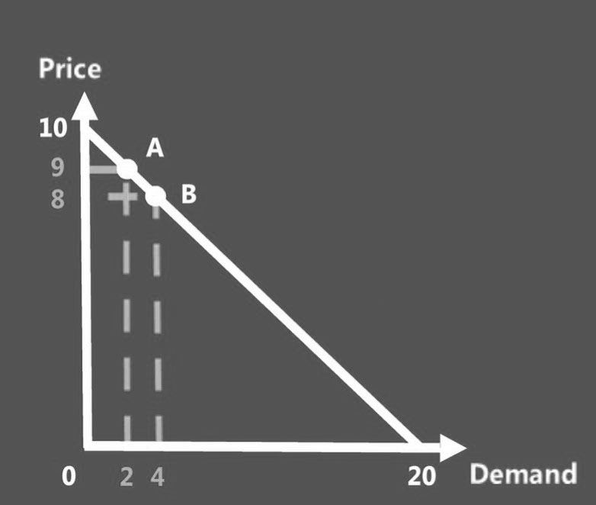
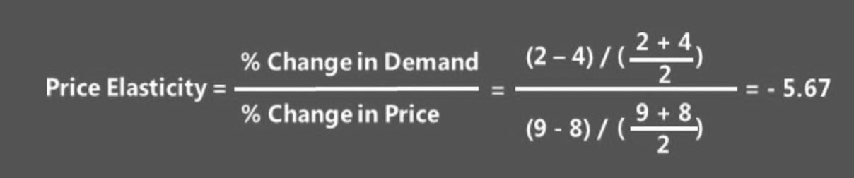
Price Elasticity Formula
We can calculate the price change from 8 to 9 in the Denominator.
The Demand changes 4 to 2 at the Numerator.
So, after calculating the result is: -5.67. That means when there are 1% increase in Price, the demand dropped.

Slide 5

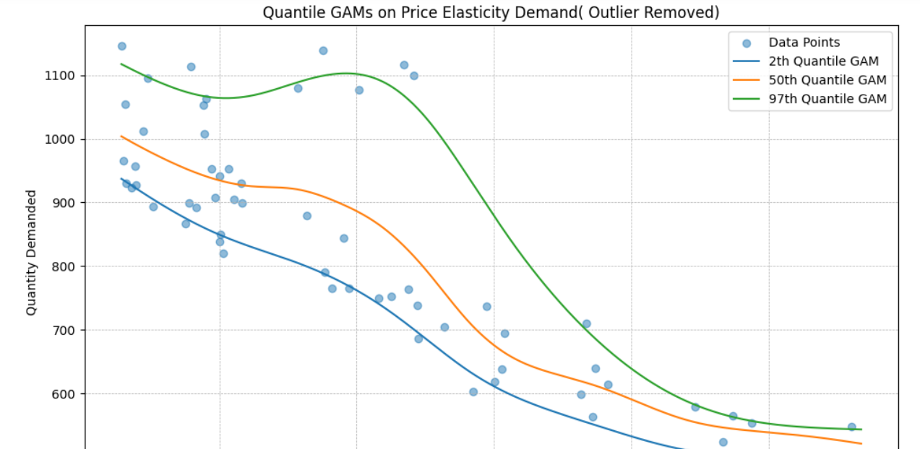


Price Elasticity – Demand Modelling
DATA SNAPSHOT
OUTPUT
OBSERVATIONS
The data set contains :
Price of product
Quantity of product sold
Benefits Of GAMs & Insights-
Quantile GAMs take into account Changing Variance- Allowing us to take into account the BEST and the WORST Case Scenarios in Price Optimization Scenarios.
From the Prediction we can see that the Blue Line – The Quantile for the Lowest/Minimum of our data.
The Orange Line tracks the median of the data & the Green Line for the Maximum.
We can Track the Upper & Lower Bounds because, in the Real-world scenario, the median can divide the data into Best-worst-case scenarios so that the Business can guess the exact estimation for that.
MODEL USED
GAM Model
GAM stands for Generalized Additive Models that smoothen the semi-parametric models in the form of:
g(E[y|X])=β0+f1(X1)+f2(X2,X3)+…+fM(XN) , where:
X.T = [X_1, X_2, ..., X_N] are the independent variables.
y is the dependent variable.
function g() is the link function that relates to the predictor variable.

Slide 6
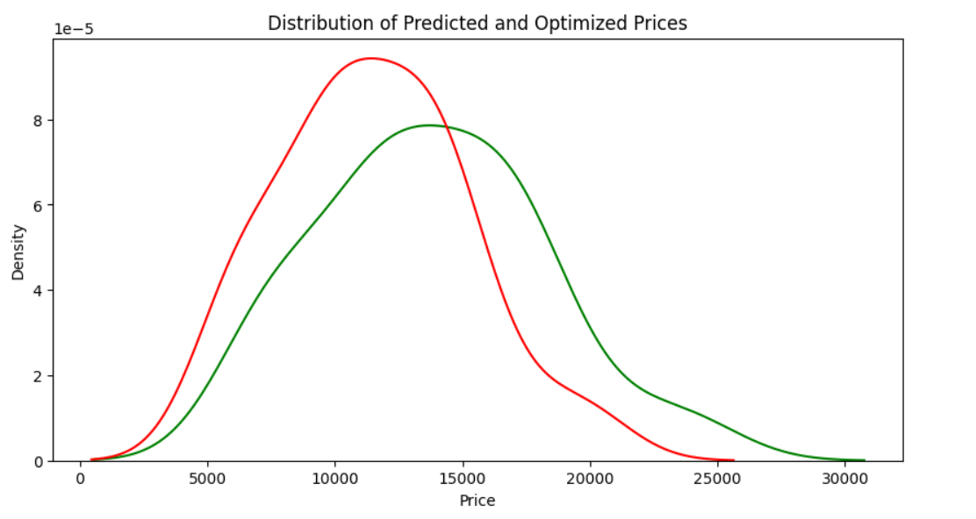
Price Elasticity – Optimization Modelling
DATA SNAPSHOT
OUTPUT / FEATURE IMPORTANCE
OBSERVATIONS
We have used a historical Airline data with featured
1. Duration 2. Price 3. Days Before Flight 4. Arrival 5. Departure Time 6. Time of Arrival 7. Stops 8. Journey Day Name 9. Non-Stop 10. Journey Day 11. Arrival Category 12. Departure Time in Hour Link: https://www.kaggle.com/code/sridharstreaks/airfare-price-prediction/input?select=Scraped_dataset.csv
In our Objective function we define the business goal.:
If the goal is to maximize revenue, then the objective function could be the overall revenue generated from selling tickets to the customers.
Constraints : These are the limitations for real- world price optimization and the requirements that should be considered when to determine the price optimization.
These constraints include maximum & minimum prices of tickets, available inventory, number of seats left, Days left before travel, or any other business constraints related to business.
Revenue before optimization: 378994.97
Revenue after optimization: 454793.96191406244
MODEL USED
XGBoost

Slide 7
Conclusion
This project allows us to identify relationships between Price and Demand, which in turn will help to :
Maximize revenue by properly pricing the products
Monitor price elasticities for changes in price and demand
Reduce manual processes to obtain and update price elasticities.
Github: https://github.com/ds-stratgic-work/Price-Elasticity-Demand.git

Slide 8


Thank You
dSights is a data tech specialist with a vision to create value through:
Outcome-Oriented AI
Fueled by
Innovative Experimentation

